Slide 1

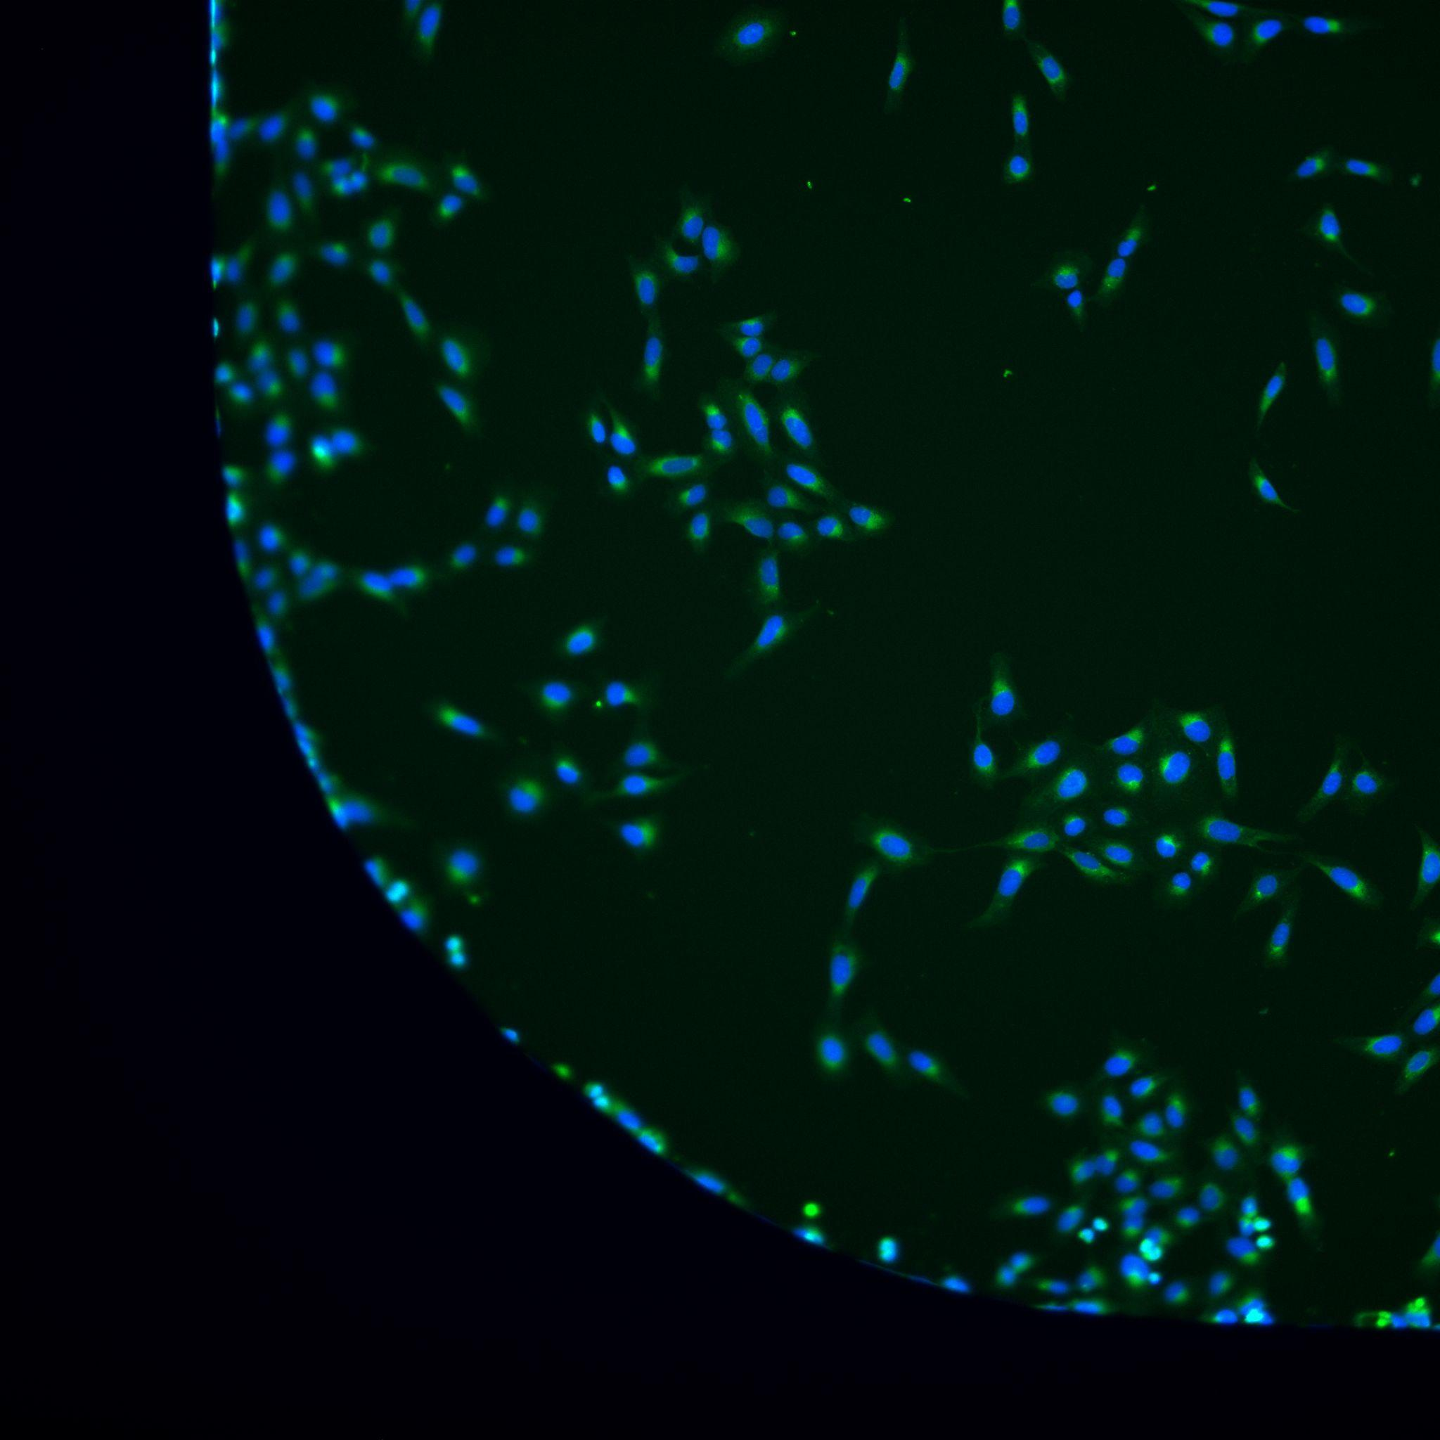
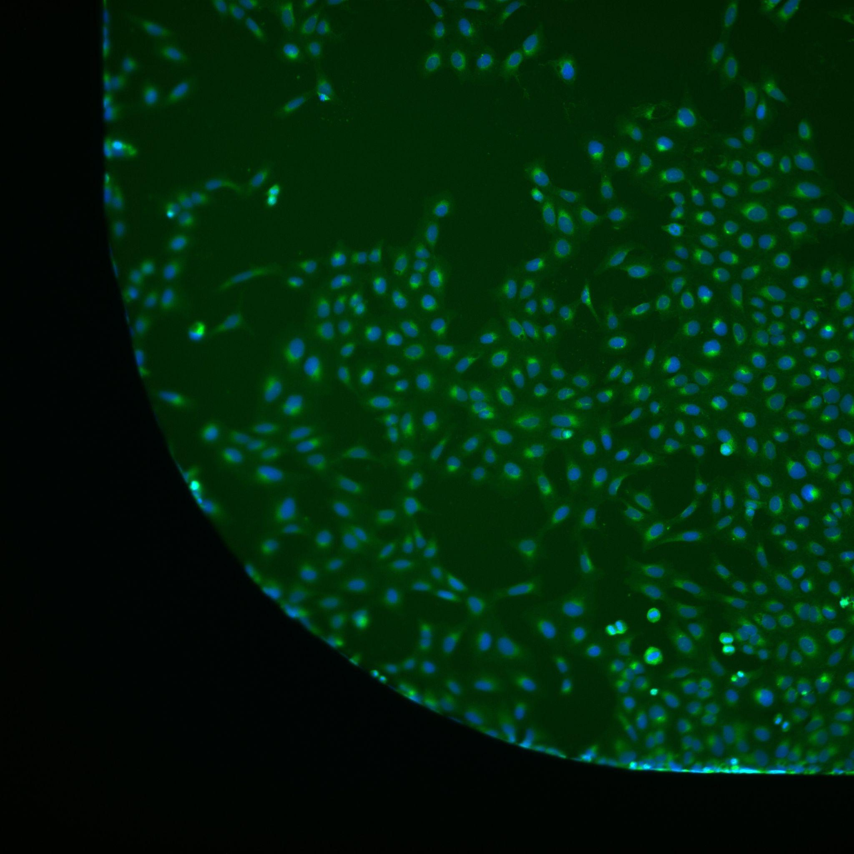
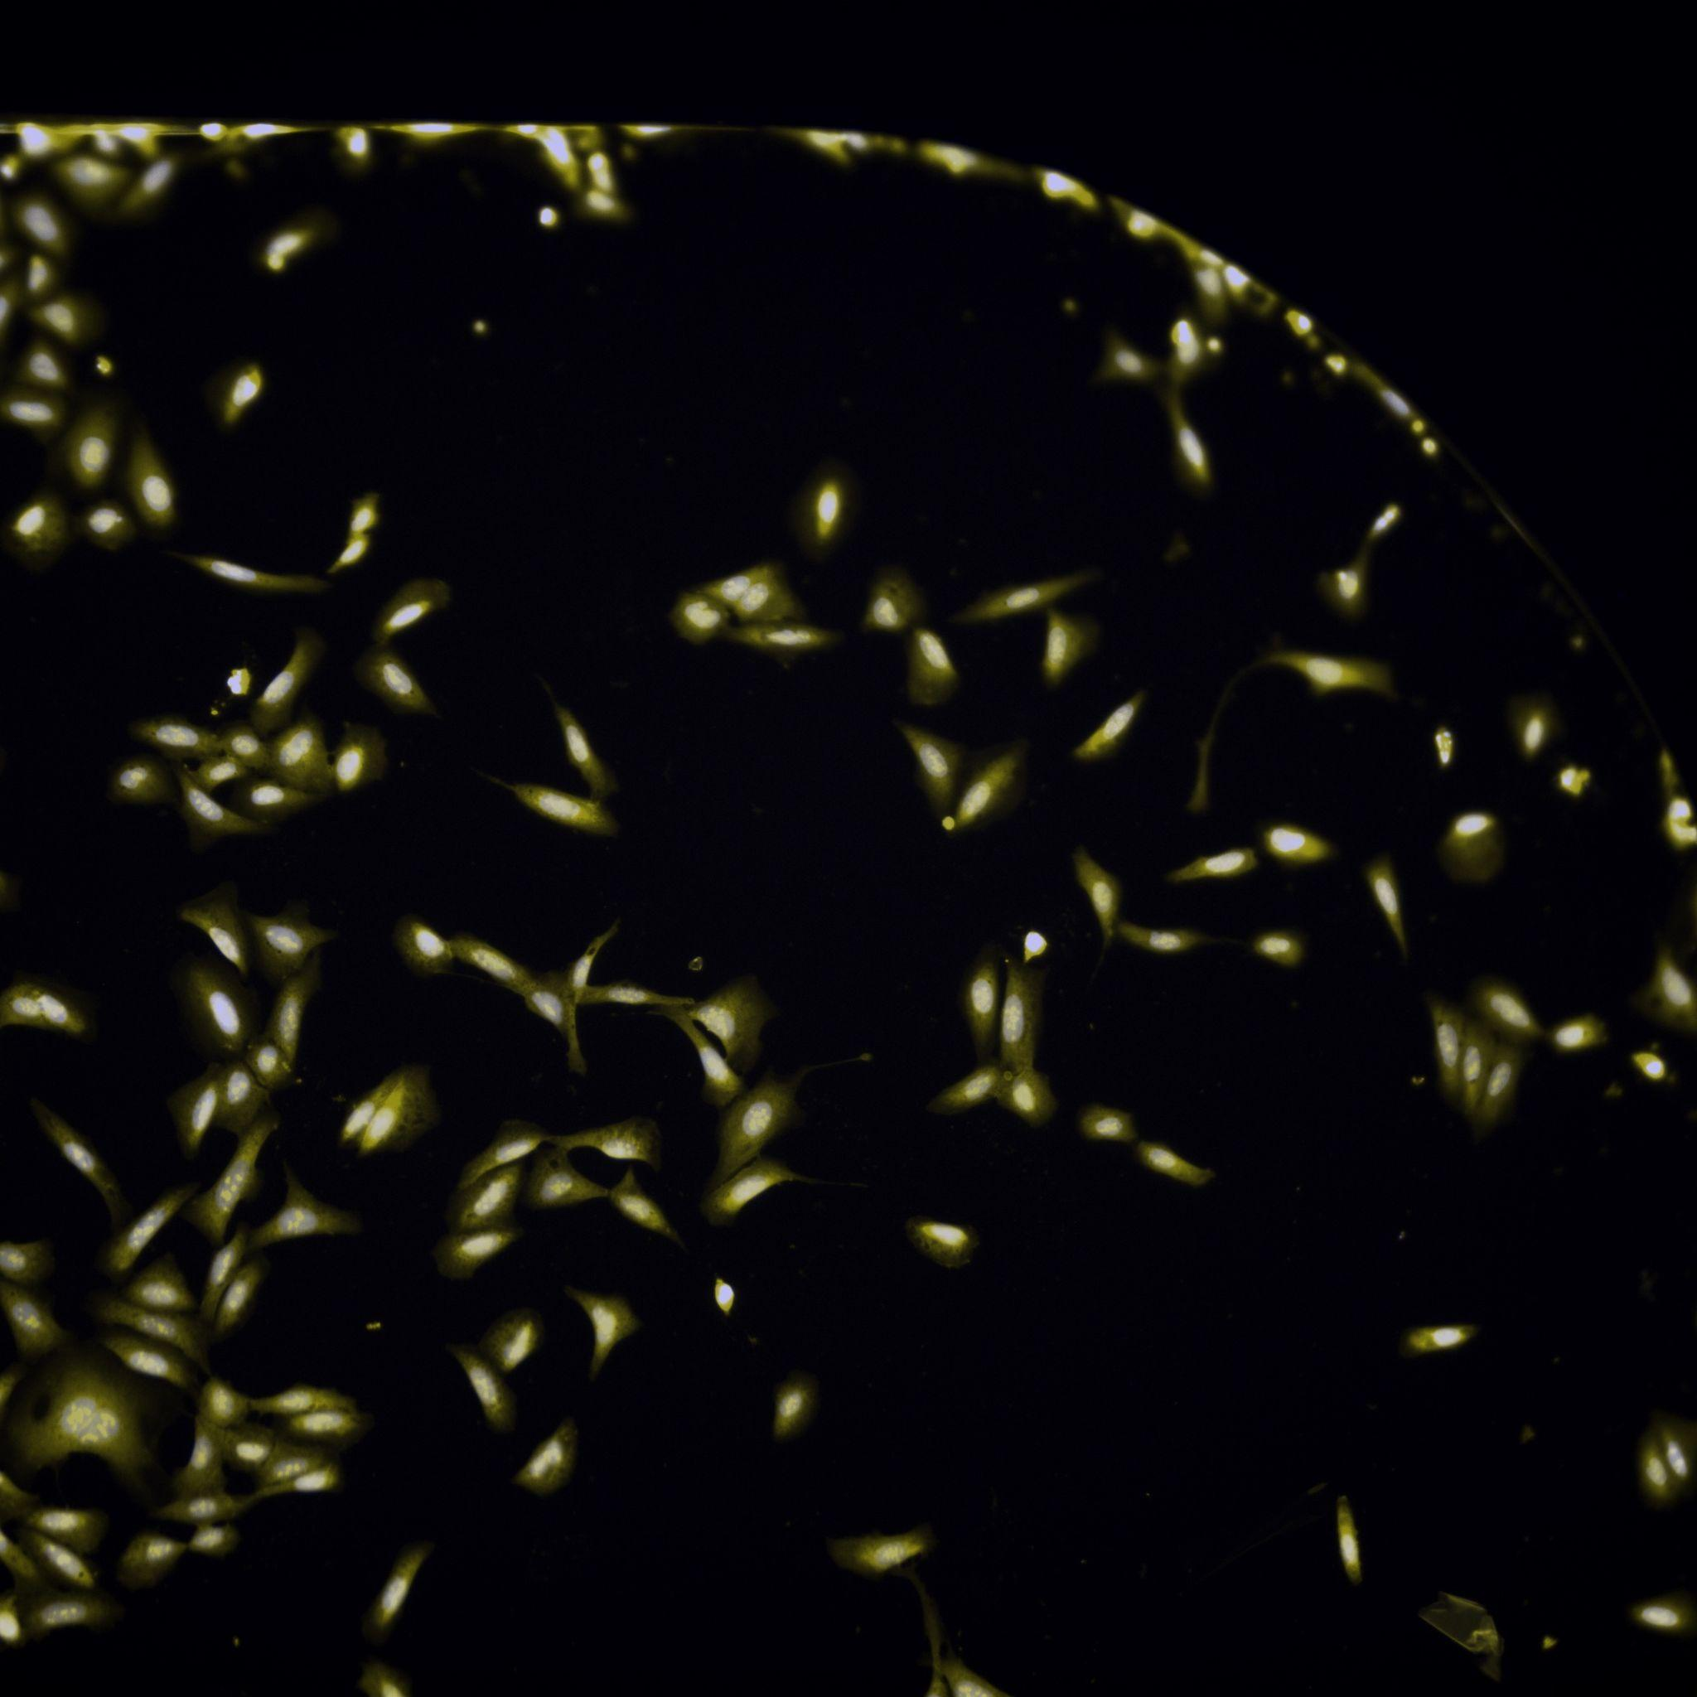
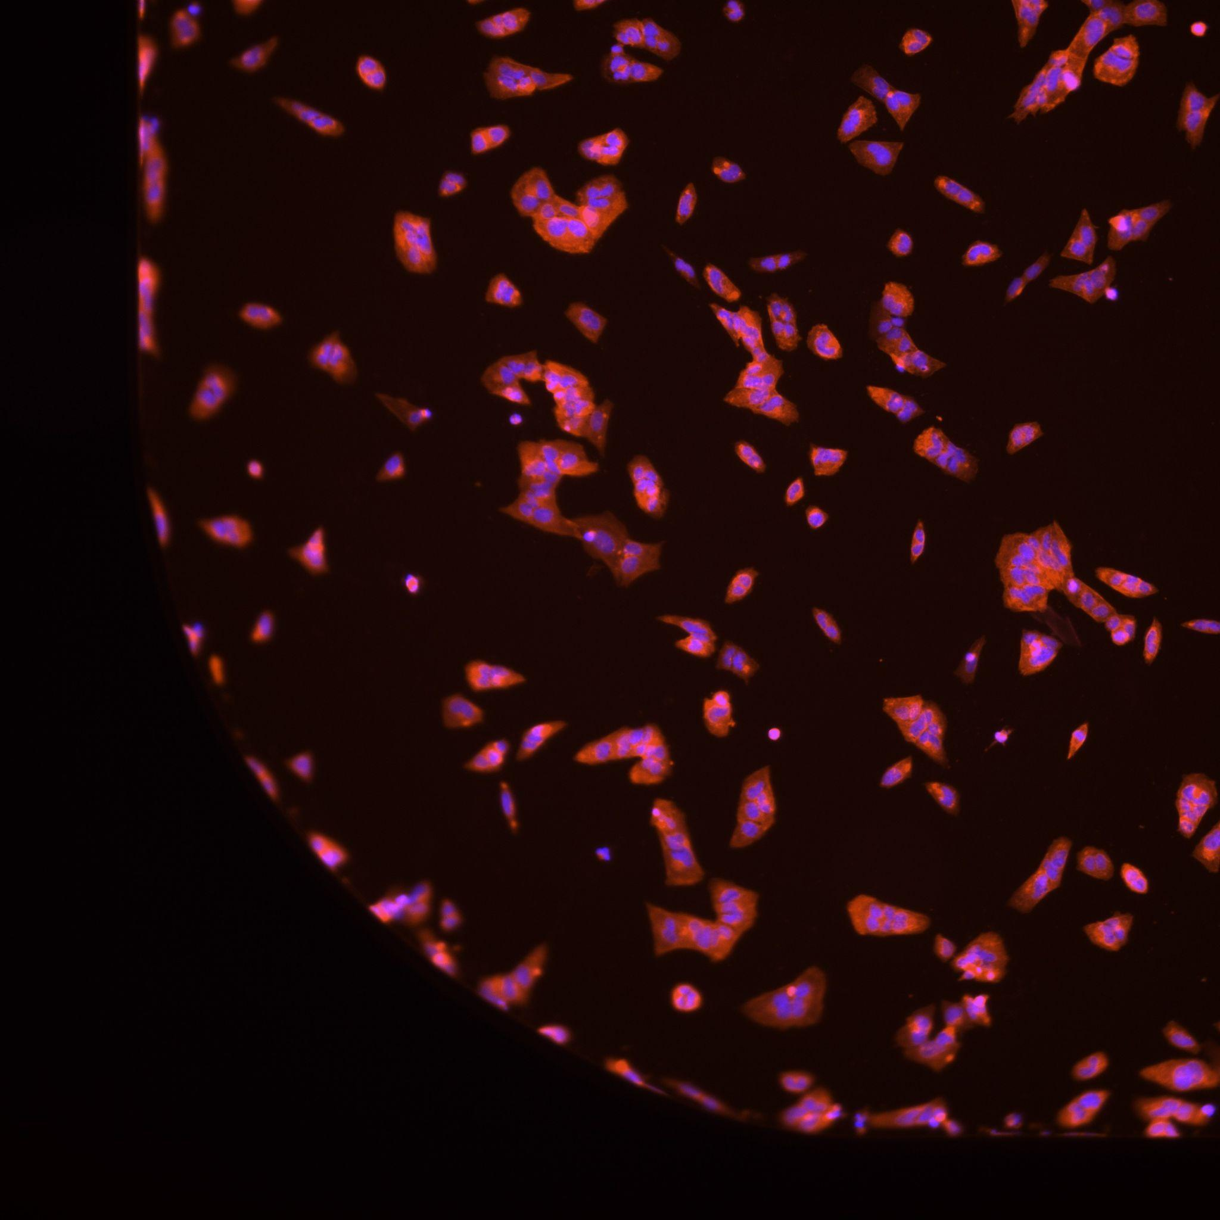
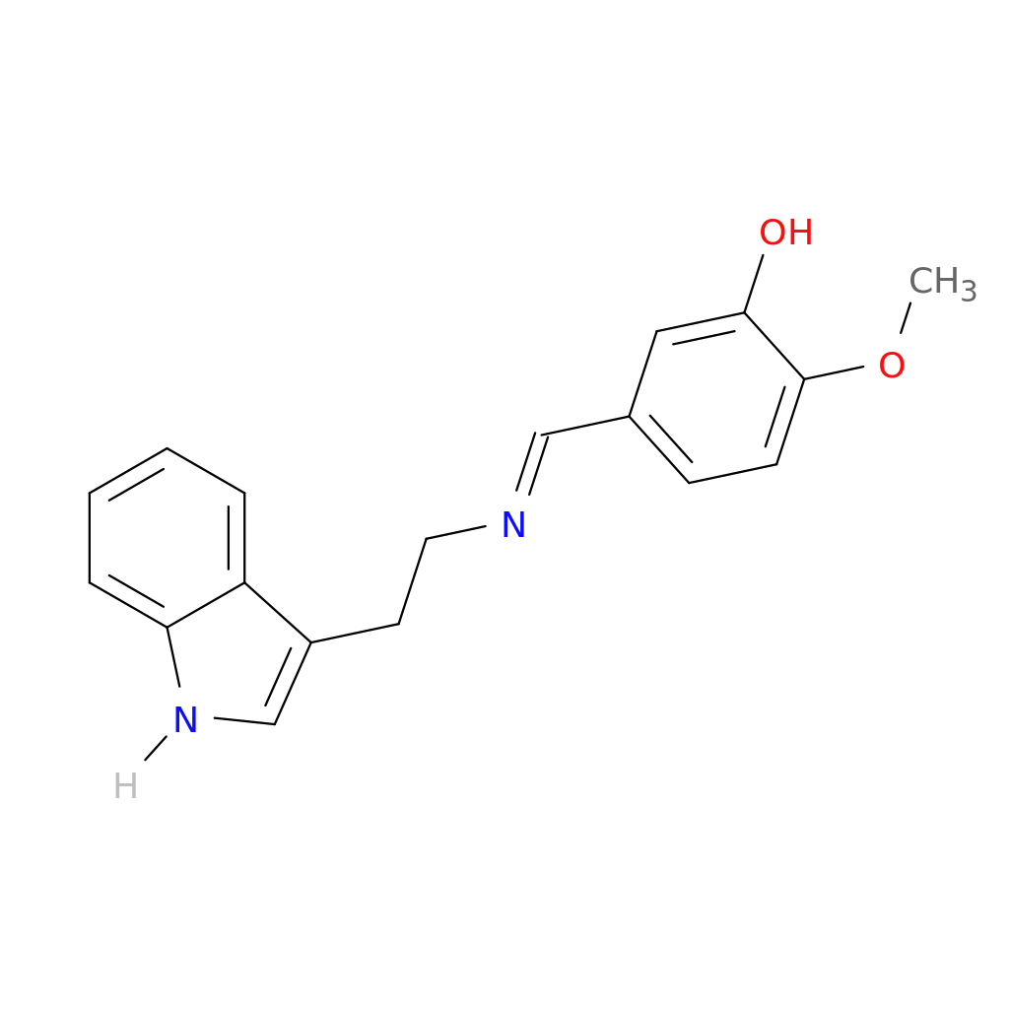
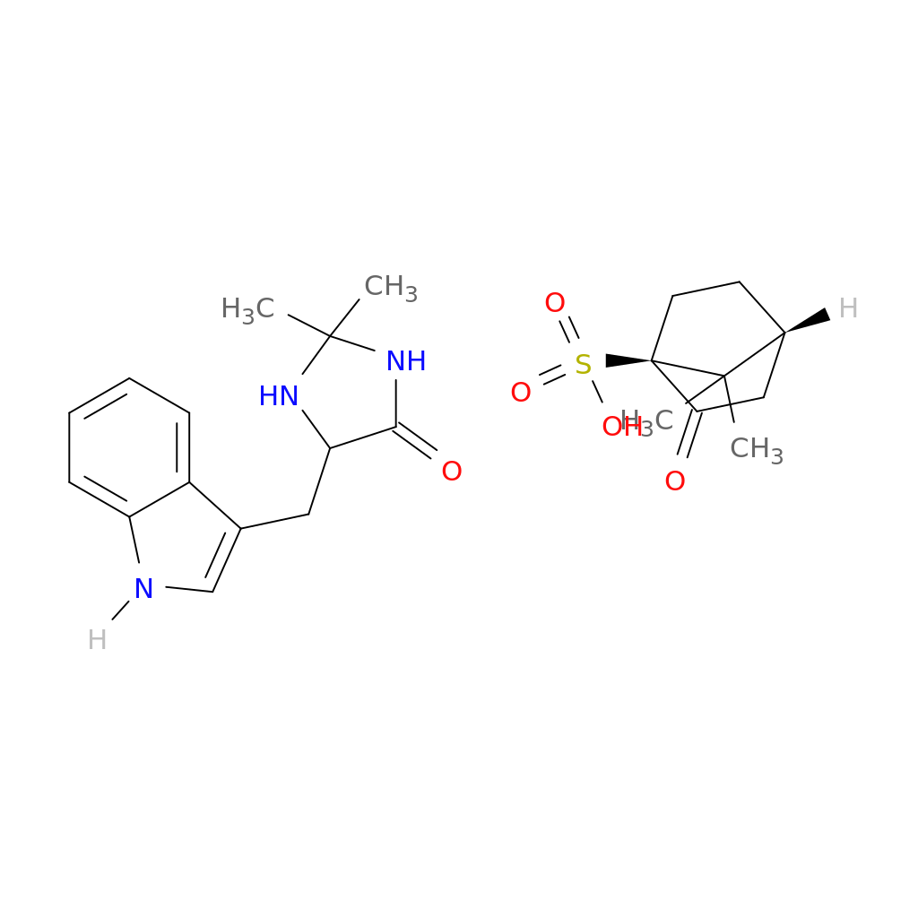
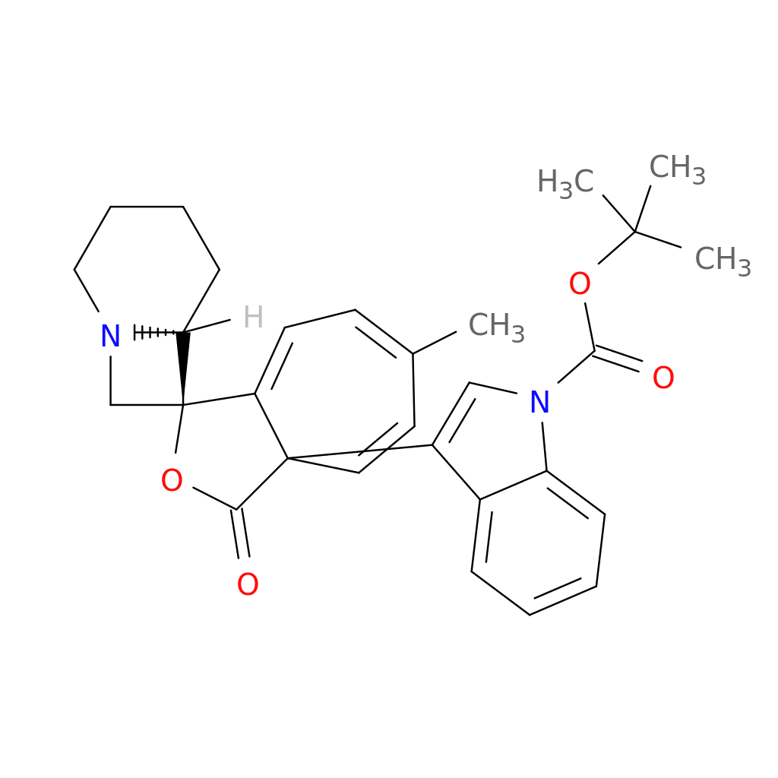
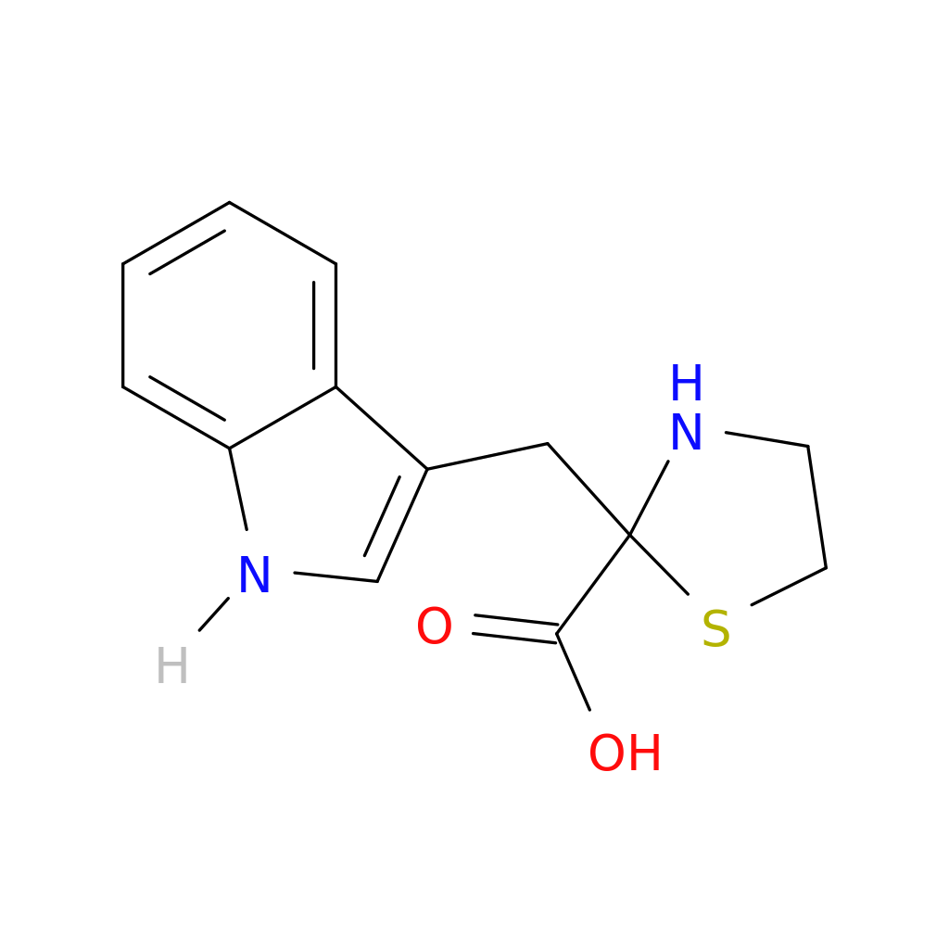
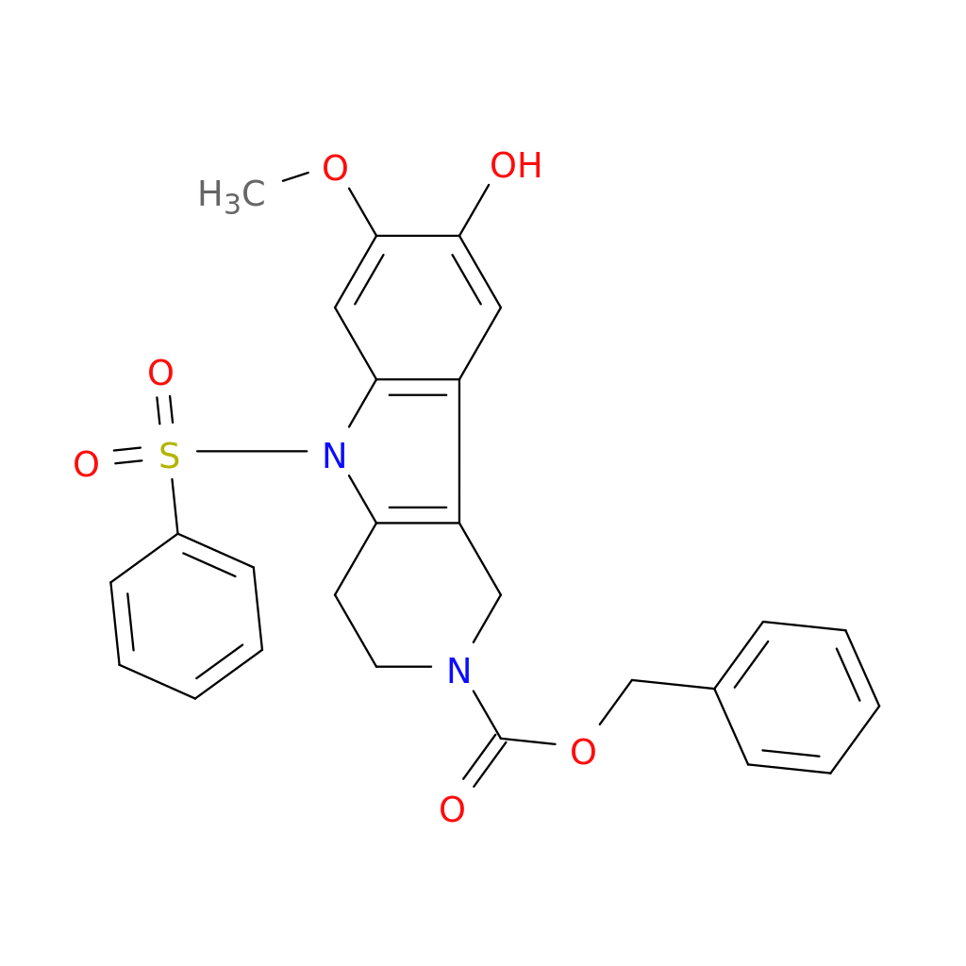
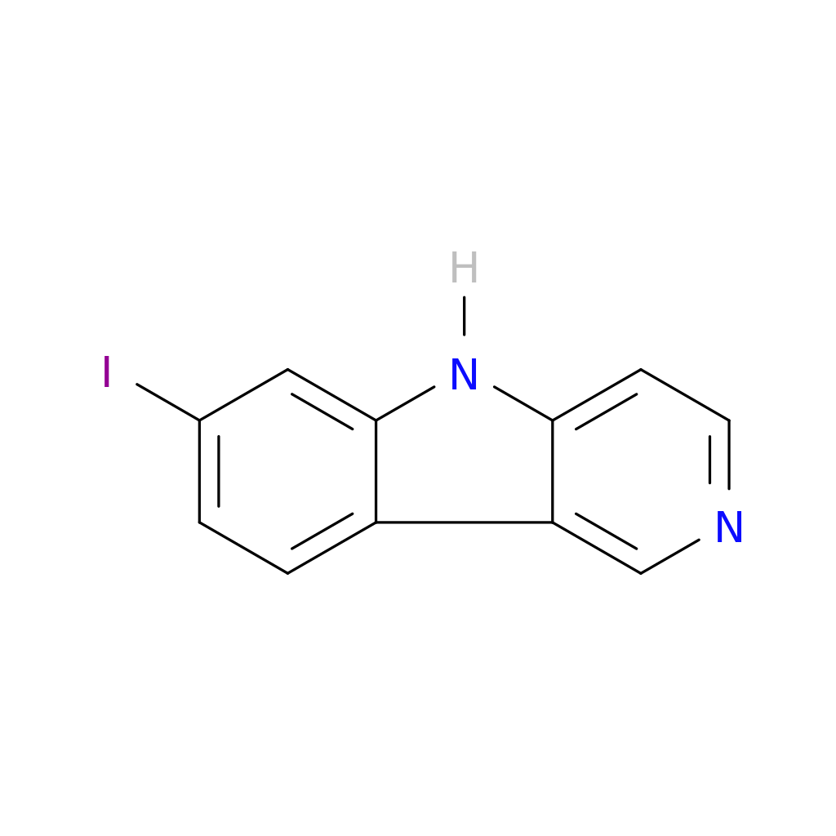
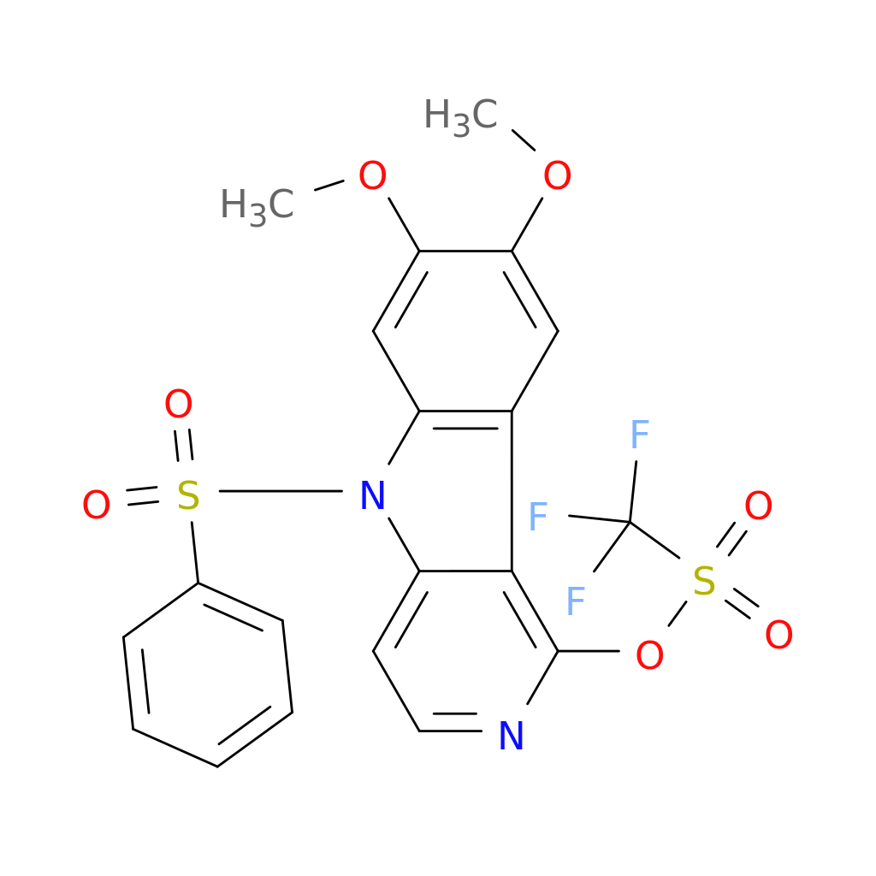
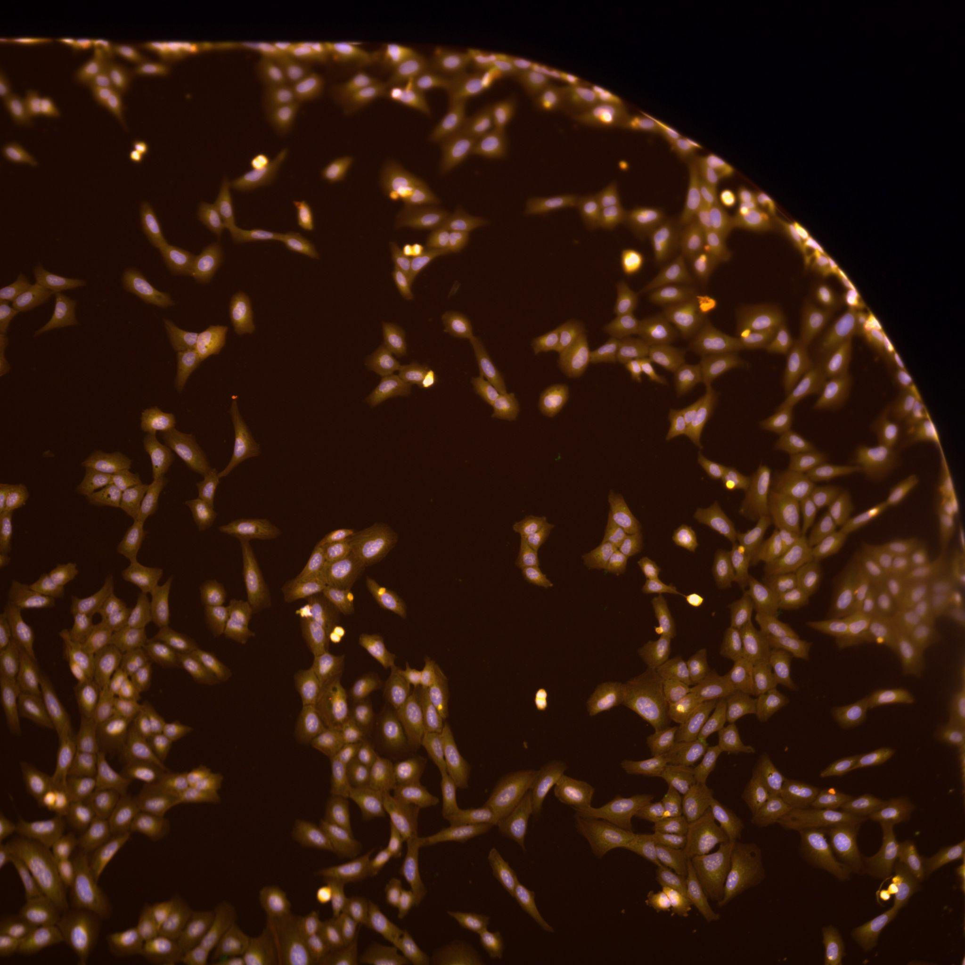
The Effect of Structurally Diverse Indoles and Monosaccharides on U2OS Morphology via Cell Painting Assay
Alhamza Y. Hamza, Manvendra Singh, Zarko Boskovic
Department of Medicinal Chemistry University of Kansas, Lawrence, KS 66045, USA
Abstract:
Results:
Cell painting is a multidimensional assay in which morphological changes in a model cancer cell line are observed. This assay allows us to monitor the activities of synthetic compounds in vitro. Following the treatment of live U2OS cells with a chemical compound at a given concentration and duration, the cells are stained with different fluorescence dyes. Those fluorescence dyes co-localize to specific cell organelles or subcellular structures. We used six unique fluorescence dyes to image the nucleus, mitochondria, cytoskeleton, cell membranes, endoplasmic reticulum, and Golgi apparatus. Then, we used fluorescence microscopy to capture images of the U2OS that were treated with chemical compounds or vehicle controls. If it is bioactive, the chemical compound might cause structural changes in the U2OS cells. Remarkably, compounds that share the way in which they are bioactive, also share similar morphological changes in this assay. Cell painting can be used as a tool to identify possible novel therapeutics and can be used to assess human gene expression. In this project, I used it to look at two distinct chemical sets: 1) indole-containing compounds, and 2) monosaccharides. Analysis of cell painting results will reveal common and distinct activities among the tested compounds.
Nuclei
Endoplasmic reticulum
Nuclei and RNA
Mitochondria
Background:
Cytoskeleton
Figure 1: Those are indole structures that use in the treatment of U2OS cells.
Aim of Study:
Approach:
Figure 2: Images slows down changes in U2OS morphologies.
To study the affection of Indole-containing compounds and Monosaccharides on the U2Os morphology
Using cell painting to collect high resolution images
Conclusions:
Cell painting can be use as a tool to identify passible morphological changes on cell such as U2OS.

